Slide 1
Nuclear Power in the 21st Century: Status
and Trends in Advanced Nuclear Technology
Development and Applications
Lecture presented at the Workshop on Nuclear Reaction Data and
Nuclear Reactors: Physics, Design and Safety
Trieste, Italy
18 March 2002
Debu Majumdar
Nuclear Power Technology Development Section
International Atomic Energy Agency (IAEA)
Vienna, Austria

Slide 2
Outline
Introduction
- IAEA
- Nuclear Energy Status
Nuclear Reactors
- Basics
- Challenge
Evolutionary Reactors
Small and Medium Reactors
Integral Reactors
Gas-cooled Reactors
Liquid Metal Reactors
Thorium Cycle
Generation IV International Forum – USDOE
INPRO – IAEA
Non-electric Application
Conclusion

Slide 3
The International Atomic Energy Agency
Membership: 130 countries;
Budget: US$ 229 million plus 87 million extra budgetary resources.
Personnel: 2170

Slide 4
The IAEA’s Statute includes the following functions:
Article III-A.1: “TO ENCOURAGE AND ASSIST RESEARCH ON, AND DEVELOPMENT AND PRACTICAL APPLICATION OF, ATOMIC ENERGY FOR PEACEFUL USES THROUGHOUT THE WORLD …”
Article III-A.3: “ TO FOSTER THE EXCHANGE OF SCIENTIFIC AND TECHNICAL INFORMATION ON PEACEFUL USES OF ATOMIC ENERGY.”

Slide 5
IAEA Principal Activities
Verification of peaceful uses;
Promotion of safety
Transfer of Nuclear Technology for peaceful purposes

Slide 6
Global energy demand
Demand is estimated to triple in 50 years
Current primary energy demand:
  54% developed countries
  34% developing countries
  By the year 2020:
  44% developed countries
  45% developing countries

Slide 7
NUCLEAR CONTRIBUTION TO ELECTRICITY GENERATION
14000
Nuclear
Hydro
Hydro
12000
19.1 %
Others
16.1 %
0.4%
10000
Thermal
8000
Nuclear
64.4 %
World's Electricity Production (TWh)
6000
2000 Share
4000
Thermal
2000
0
1950
1960
1970
1980
1990
2000
Year

Slide 8
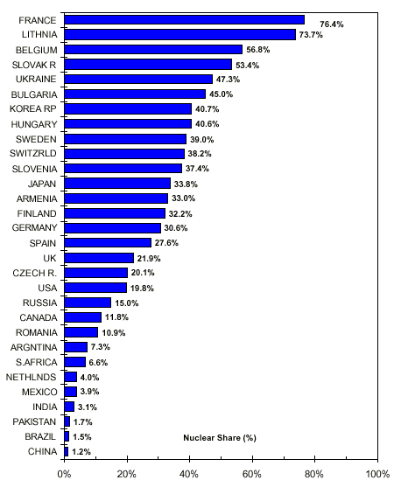
NUCLEAR PLANTS GENERATE ELECTRICITY
IN MANY COUNTRIES
Nuclear Share (%)
of Electricity Generation
in 2000
Global Nuclear Share:
~ 16%, 2450 TWh
Note: The nuclear share of electricity supplied in Taiwan, China was 23.6% of the total.
Note: The nuclear share of electricity supplied in Taiwan, China was 23.6% of the total.

Slide 9
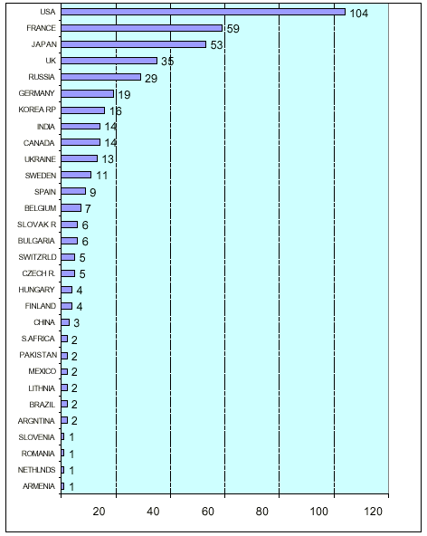
MANY REACTORS
ARE OPERATING
IN THE WORLD
Number of Nuclear Reactors in Operation and under Construction
in 2000
In Operation: 438
Total Capacity: 351 GWe
Under Construction: 33
Total Capacity: 28.6 GWe
Operating Experience: 9819 RYs
Number of Countries: 31
(Including Taiwan, China)
Note: Six reactors are in operation in Taiwan, China

Slide 11
Nuclear Energy
Hot Source
Cold Fluid
Hot Fluid
Nuclear
Reactions
FUEL
PRIMARY COOLANT

Slide 12


Indirect Cycle
T₁
T₂
Gases: Compressor
Liquids: Pumps
PRIMARY
COOLANT
SECONDARY COOLANT

Slide 13
Direct Cycle
T₁
T₂
PRIMARY COOLANT

Slide 14
Reactor Types
PWR
CANDU
BWR
Magnox
AGR
HTGR
RBMK
FR

Slide 15
TABLE 1: MAIN TYPES OF NUCLEAR POWER REACTORS
Reactor Type | Fuel | Moderator | Coolant (pressure in bars) | Steam generation
PWR | uranium dioxide (approx. 3.2% U-235) | ordinary water | pressurized water (160 bars) | separate circuit
CANDU | Unenriched uranium dioxide (0.7% U-235) | heavy water | heavy water pumped at pressure (90 bars) | separate circuit
BWR | uranium dioxide (2.6% U-235) | ordinary water | pressurized ordinary water which boils and produces steam directly (70 bars)
Magnox | natural uranium | graphite | carbon dioxide (40 bars) | separate circuit
AGR | uranium dioxide (2.3% U-235) | graphite | carbon dioxide (20 bars) | separate circuit
HTGR | uranium dioxide in coated particle fuel (approx. 8-19%) | graphite | helium (approx. 60 bars) | separate circuit or direct helium cycle
RBMK | uranium dioxide(2.4% U-235) | graphite | pressurized ordinary water which boils and produces steam directly (70 bars)
FR | uranium/plutonium oxide (about 16-20%) | None | liquid sodium at low pressure (~5 bar) | separate circuit

Slide 16
Nuclear Power Challenges
The Challenges facing nuclear power include:
Continuing to assure the highest level of safe operation of current plants,
Implementing disposal of high level waste,
Achieving consensus on the effects of small doses of radiation,
Establishing a sound basis for defining the potential of nuclear power to contribute to sustainable development.

Slide 17
Nuclear Power Challenges
(Cont’d)
Achieving further technological advances to assure that future nuclear plants will be economically competitive with fossil alternatives, especially in deregulated and privatised electricity markets;
Developing economical small and medium sized reactor designs to provide the nuclear power option to developing countries which have small electricity grids, and also for non-electric applications such as seawater desalination, and
Preserving intellectual capabilities in nuclear power technology.
IAEA addresses all of these challenges
in its programmatic activities.

Slide 18
To assure that nuclear power remains a viable option, considerable design and development is underway worldwide
New designs are being developed for all major lines (LWRs, HWRs, HTGRs, LMRs)
Common goals
  High availability,
  Competitive economics
  Compliance with stringent safety objectives
Expenditures are more than US$2B/year-reflecting confidence in the future of nuclear power

Slide 19
Advanced Designs
  Evolutionary designs which aim to achieve improvements over existing designs through small to moderate modifications
  Innovative designs which incorporate radical conceptual changes in design approaches or system configuration and may require a prototype or demonstration plant as part of the development programme.
Innovative designs
Prototype
and/or
Demonstration plant
+
Confirmatory testing
+
Engineering
Cost of Development
Evolutionary designs
Confirmatory
testing
+
Engineering
Engineering
Substantial R&D
Departure from Existing Designs

Slide 20
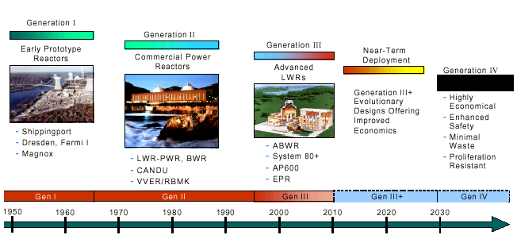

Slide 21
SOME EVOLUTIONARY WATER COOLED REACTORS ARE STARTING OPERATION OR ARE UNDER CONSTRUCTION, OTHERS HAVE BEEN CERTIFIED BY REGULATORY AUTHORITIES, AND SOME ARE UNDER DEVELOPMENT...
Evolutionary LWRs
  USA/Japan: 1360 MWe ABWR (GE-Hitachi-Toshiba) and
  1700 MWe ABWR-II (Japanese utilities, GE-Hitachi-Toshiba); and 1530 MWe APWR (Mitsubishi-Westinghouse)
  USA: 600 MWe AP-600 and 1350 MWe System 80+ (Westinghouse) and
  1350 MWe ABWR (General Electric);
  also: 1000 MWe AP-1000 (Westinghouse) and 1380 MWe ESBWR
  France/Germany: 1545 MWe EPR and 1000 MWe SWR-1000 (Framatome ANP)
  Rep. of Korea: 1000 MWe KSNP⁺ and 1400 MWe APR-1400 (KEPCO and Korean Industry)
  Sweden: 1500 MWe BWR90+ (Westinghouse Atom )
  Russia: WWER-1000 (V-392); WWER-1500; and WWER-640 (V-407) (Gidropress and Atomenergoprojekt)
  China: 1000 MWe CNP-1000 (CNNC) and 600 MWe AC-600 (NPIC)

Slide 22
SOME EVOLUTIONARY WATER COOLED REACTORS ARE STARTING OPERATION OR ARE UNDER CONSTRUCTION, OTHERS HAVE BEEN CERTIFIED BY REGULATORY AUTHORITIES,
AND SOME ARE UNDER DEVELOPMENT
Evolutionary HWRs
  Canada: AECL’s evolutionary CANDU programme
    700 MWe CANDU-6
    935 MWe CANDU-9
    400-650 MWe Next Generation CANDU
  India: Nuclear Power Corporation of India, Ltd.
    500 MWe HWR

Slide 23
Overview of Toshiba, Hitachi and General Electric ABWR
Development started in 1970s (by design organizations and utilities, with support from government of Japan)
strong application of “test before use”, even if features had been incorporated in BWRs outside of Japan
Key developments: reactor internal pumps, improved control rod drives, re-inforced concrete containment, improved efficiency turbine, additional means of injecting water under accident conditions, advanced I&C and control room
2 ABWRs (1356 MWe) are operating: Kashiwazaki-Kariwa Unit 6 (construction: 11/92-12/96); Unit 7 (construction: 7/93-7/97)
2 ABWRs are under construction (Hamaoka-5 and Shika-2) in Japan, and 8 more are planned
U.S. version was designed to meet EPRI URD and received U.S.NRC Design Certification (5/97)
2 units under construction in Taiwan, China

Slide 24
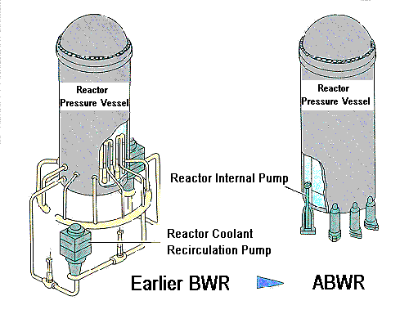
The ABWR reactor coolant re-circulation pumping system is simpler

